Slide 1
Invasive pulmonary aspergillosis and COVID-19 (CAPA) in critically unwell patients: A year-long retrospective case series
Dr Barbara Salas, FY2 doctor
Dr Katie Cranfield, Intensive Care Medicine Consultant
Dr Iain McCullagh, Intensive Care Medicine Consultant
Ms Christine Fagan, Senior Biomedical Scientist
Ms Angela Geering, Data Manager and Senior Biomedical Scientist
Dr Ali Robb, Consultant Microbiologist

Slide 2
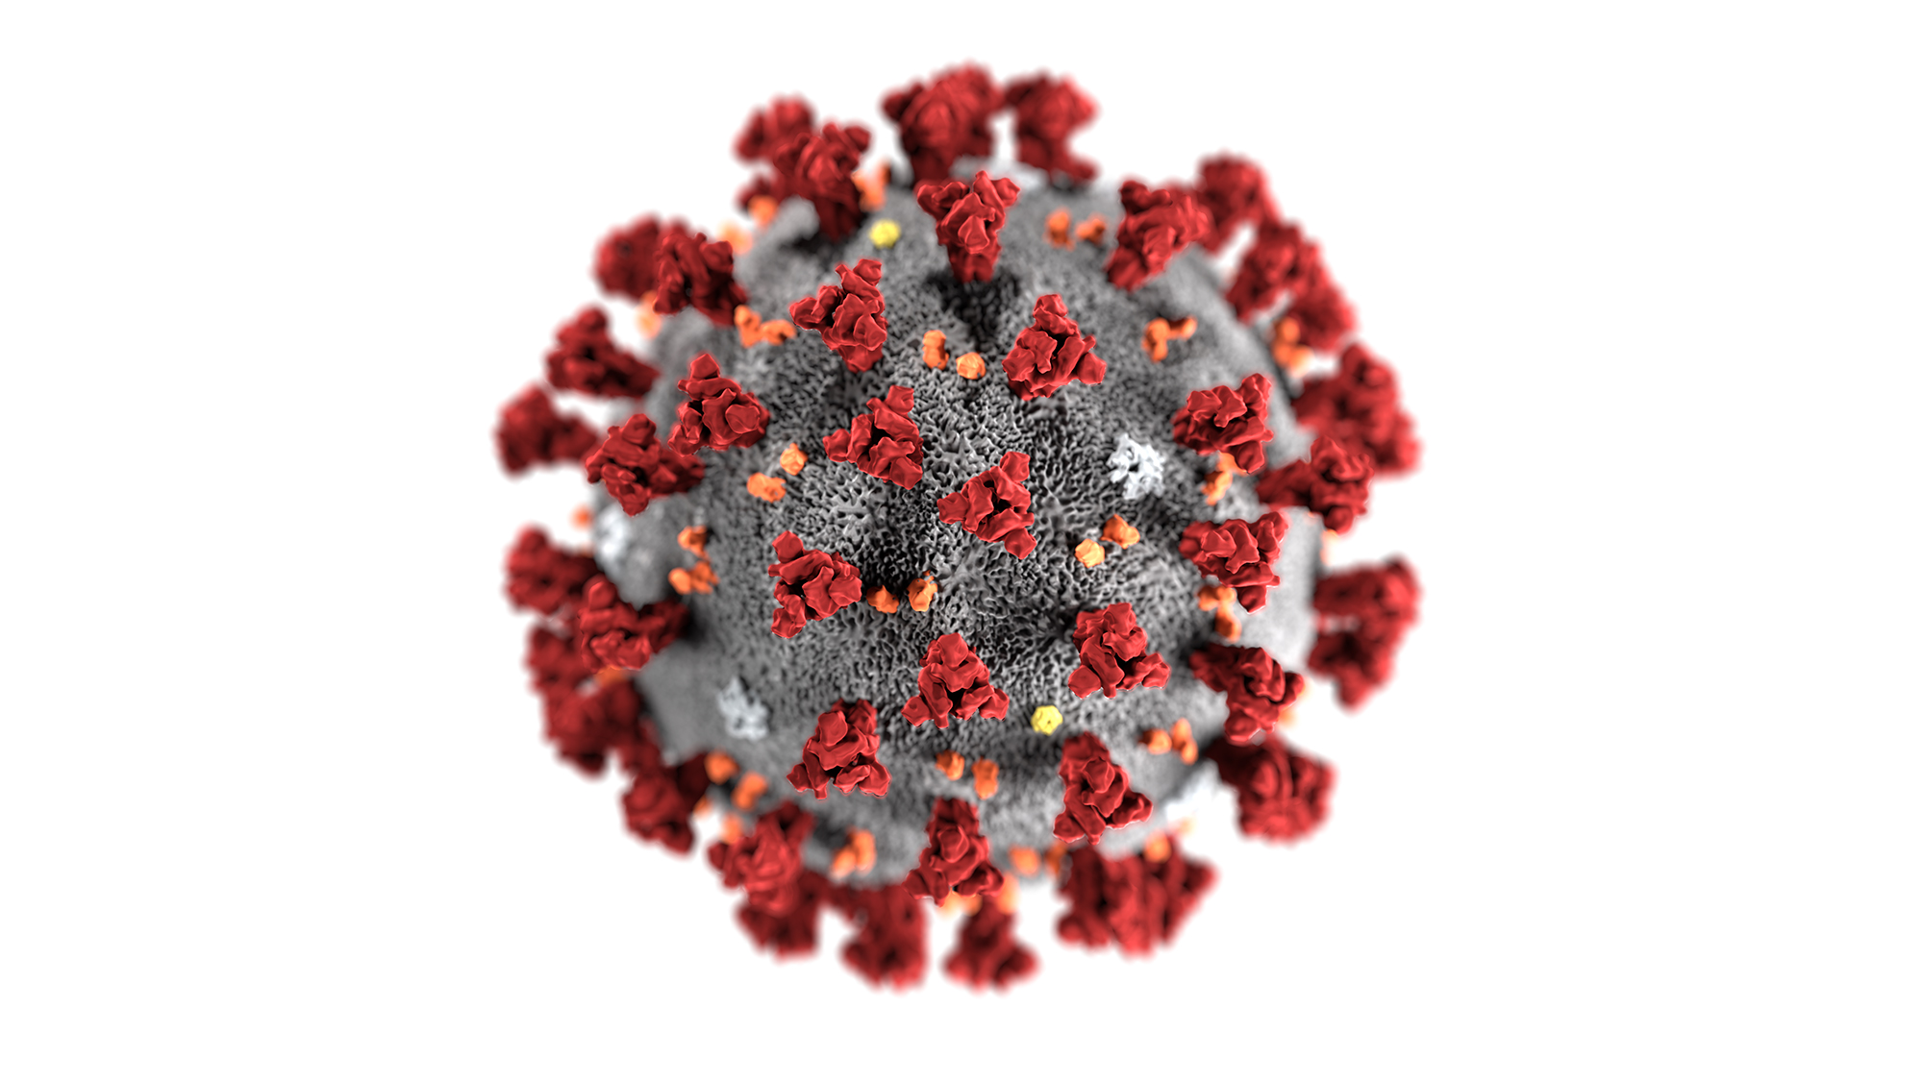
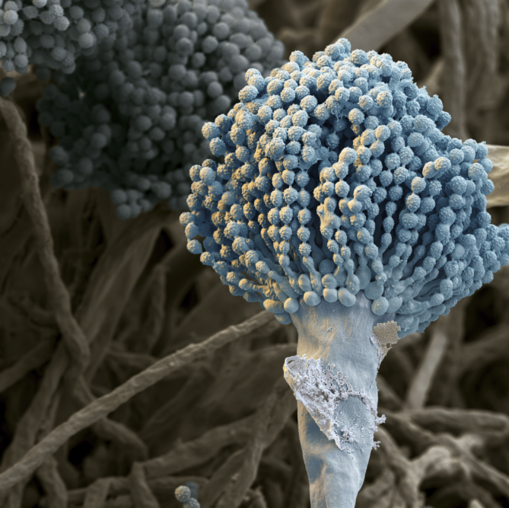
AIMS
Background
Methods
Results
Conclusions from results
Limitations
Recommendations
Next steps

Slide 3
1. BACKGROUND
COVID-19 and Aspergillosis
Increasing number of reports on COVID-19 and associated pulmonary aspergillosis (CAPA).
Severe ARDS & COVID-19 leads to direct damage to the airway epithelium and abnormal ciliary clearance: Aspergillus invasion.
Higher mortality rate (44% vs 19% in Bartoletti et al., 2020) (meta-analysis Singh et al, 2021).
However, little is known about the epidemiology, pathophysiology, diagnosis and best treatment options for patients with CAPA.

Slide 4
COVID-19 and Aspergillosis
No generally accepted case definition for patients with CAPA.
The Lancet 2021: Consensus paper by the European Confederation for Medical Mycology and the International Society for Human and Animal Mycology.
For clinical studies: CAPA = ‘IPA in temporal proximity to a preceding SARS-CoV-2 infection’ especially patients requiring ICU.
Three different grades: possible, probable, and proven based on host factors, clinical factors and mycological evidence.
IPA=invasive pulmonary aspergillosis

Slide 5
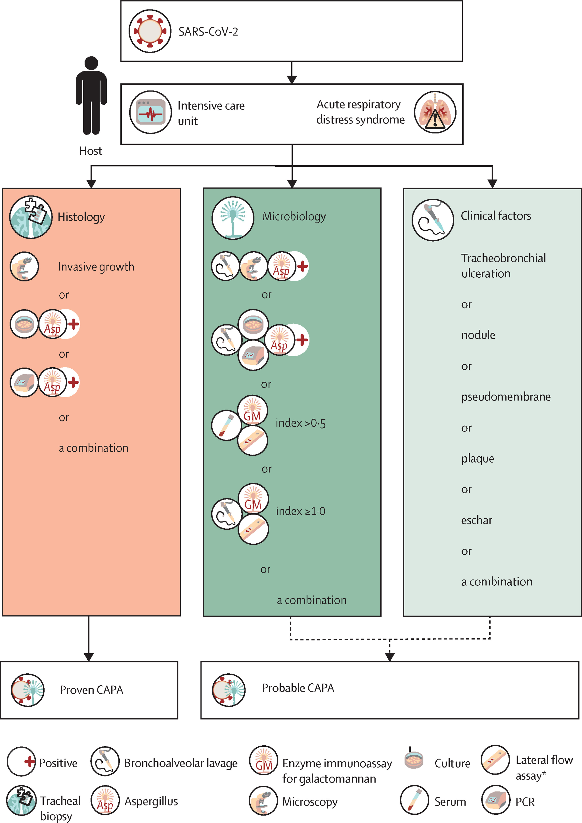
The Lancet Infectious Diseases 2021
DOI: (10.1016/S1473-3099(20)30847-1)
Consensus paper
European Confederation for Medical Mycology and the International Society for Human and Animal Mycology (2021)

Slide 6
Diagnosis of CAPA
Multiple pulmonary nodules or lung cavitation should prompt thorough investigation for IPA.
Detection of galactomannan in bronchoalveolar lavage fluid is highly indicative of IPA (antigen is released during active fungal growth).
Unfortunately, the diagnostic yield of serum galactomannan is low in CAPA:
- At best, 20% of patients showed positive results.
- Proven CAPA cases have been reported with negative serum galactomannan.

Slide 7
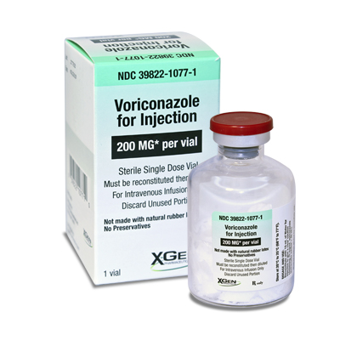
Treatment of CAPA
First-line treatment: Voriconazole or Isavuconazole.
If azole resistance is a concern, then Amphotericin B is the drug of choice.
The optimal duration of therapy is unknown.
The expert panel suggest 6-12 weeks of treatment.

Slide 8
2. METHODS
Our aim:
Further the knowledge of this emerging disease.
Incidence, demographics, co-morbidities, investigations, time to diagnosis, treatment and 30-day outcome of patients with CAPA admitted to critical care in The Newcastle upon Tyne Hospitals NHS Foundation Trust between March 2020-March 2021.

Slide 9
2. METHODS
How did we do it?
Data analysis of all adult COVID-19 positive patients who also had:
1. Isolated Aspergillus spp. from a respiratory sample, or
2. Positive Aspergillus antigen test from a clinical sample.
E-Records Freeman and RVI patients (incl. patients from other areas outside North-East).
Consensus criteria for research and clinical guidance from the European Confederation for Medical Mycology and the International Society for Human and Animal Mycology (The Lancet, 2021).

Slide 10
3. RESULTS
9 MALES vs 4 FEMALES | 67.2 YEARS-OLD | HTN (7; 53.8%) *Average: 4* | ALL | 1 patient on steroids (GCA) | ALL Consolidation (6; 46.1%)
13 patients in total (October 2020 – March 2021) | 53-81 years-old | COPD (4; 30.7%) CVD (3; 23%) OA (3; 23%) T2DM (3; 23%) CKD (3; 23%) BMI >25 (2) High cholesterol (2) | After a median of 1 day post ICU admission | All received dex Tocilizumab (7; 53.8%) Remdesevir (3; 23%) | Pulmonary infiltrates (5; 38.4%) Cavitation (2; 15.4%) CXR and CT

Slide 11
3. RESULTS
BAL 100% Sputum culture: 77% (10) | 18.2 days post covid infection | 11 patients received antifungal treatment (77%) | 9 deaths (69%)
Galactomannan antigen (3; 23%) Aspergillus fumigatus spp. | 11 days post ICU admission 8.4 days post intubation | Caspofungin (8) Voriconazole (3) Monotherapy <2 weeks treatment | 1 died on day 32 3 (23%) survived

Slide 12
4. CONCLUSIONS FROM RESULTS
Four key points
1. Lack of positive tests between March-October 2020.
2. Impact of immunosuppression.
3. High mortality rate.
4. Antifungal treatment choice and course duration.

Slide 13
Lack of positive tests March-October 2020 | Immunosuppression | High mortality rate | Antifungal treatment choice and course duration
Rapid decline/mortality (Spring 2020). BAL = AGP Serum galactomannan has low diagnostic accuracy Lack of testing | All treated with dexamethasone as per RECOVERY trial. Tocilizumab and Remdesevir also given. Improve survival but impair immune system: higher risk of superinfection with fungal pathogens. More research needed | Research: excess mortality 16-25% compared with patients without Aspergillosis. Our cohort: 69% mortality = severe consequences of CAPA | Only 3 patients received voriconazole (recommended): major drug-drug interactions and narrow therapeutic window Lack of guidelines and awareness Caspofungin monotherapy was the most common treatment. 6-12 weeks treatment vs our median of 6-10 days.
AGP = aerosol generating procedure

Slide 14
5. LIMITATIONS
Retrospective clinical data:
Outcome of interest had already occurred.
Couldn’t control or assess exposure.
Confounding bias (distortion between exposure and outcome).
Patients may have been missed.
No systematic culture of BALs.
Patients from ICUs outside our Trust (lack of access to records).

Slide 15
6. RECOMMENDATIONS
COVID-19 positive patients who develop respiratory insufficiency requiring ICU treatment should be considered at high risk for CAPA.
- CAPA might develop within few weeks.
- Corticosteroids or IL-6 inhibitors may increase the risk.
For diagnosis, bronchoalveolar lavage fluid is the specimen of choice.
- Galactomannan in bronchoalveolar lavage fluid: highly indicative of aspergillosis.
Another biomarker, namely (1–3)-β-D-glucan, for serum screening may be beneficial.

Slide 16
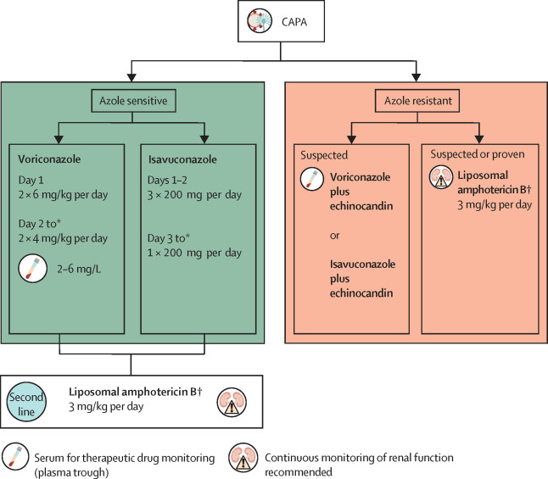
6. RECOMMENDATIONS (cont’d)
Voriconazole / Isavuconazole. Alternative: Amphotericin B.
2nd line: Posaconazole or echinocandins (NOT to be used as monotherapy).
6-12 weeks.
The Lancet Infectious Diseases 2021 DOI: (10.1016/S1473-3099(20)30847-1)

Slide 17
7. NEXT STEPS
Submission for publication.
Raise awareness: presentation of findings (especially microbiology and critical care medicine departments):
- Wards 18 & 38: Wednesday 22nd Sept
Ongoing data analysis.

Slide 18
THANK YOU!
Any questions?
Acknowledgments:
Drs Katie Cranfield and Iain McCullagh for sharing their knowledge and experience treating patients with CAPA
Ms Christine Fagan for sharing her lab testing knowledge
Ms Angela Geering for key data gathering
Dr Ali Robb for invaluable support, enthusiasm, excellent feedback and huge contribution to this project!

Slide 19
REFERENCES
Bartoletti M, Pascale R, Cricca M, et al. Epidemiology of invasive pulmonary aspergillosis among COVID-19 intubated patients: a prospective study. Clin Infect Dis. 2020 (published online July 28.) https://doi.org/10.1093/cid/ciaa1065
Koehler P, Bassetti M, Chakrabarti A, et al. Defining and managing COVID-19-associated pulmonary aspergillosis: the 2020 ECMM/ISHAM consensus criteria for research and clinical guidance, The Lancet Infectious Diseases 2021 DOI: (10.1016/S1473-3099(20)30847-1)
Singh S, Verma N, Kanaujia R, Chakrabarti A, Rudramurthy SM. Mortality in critically ill patients with coronavirus disease 2019-associated pulmonary aspergillosis: A systematic review and meta-analysis. Mycoses. 2021 Sep;64(9):1015-1027. doi: 10.1111/myc.13328. Epub 2021 Jun 14. PMID: 34057252.

